Slide 1
Tuition Management System
The ultimate smart learning hub

Slide 2
PRESENTED BY
Name | ID | INTAKE
Md. Shahuidul Islam Parvez | 22234103123 | 50
Noor Uddin Yousuf Shanto | 22234103136 | 50
Akkas Uddin | 22234103137 | 50
Md. Rahat Bin Israil | 22234103139 | 50
Md. Saidul Islam | 22234103142 | 50
Jannatul Ferdous Prity | 22234103239 | 50
Md. Jahid Hossain | 21224103155 | 48
SUPERVISED BY
Md. Masudul Islam
Assistant Professor,
Department of CSE

Slide 3
TABLE OF CONTENTS
Problem Overview
Objective
Background Analysis
Development Model
System Architecture
Context Level Diagram
Use Case Diagram
Data Flow Diagram
System Flowchart
System Requirement
Modules
Prototype Designs
Future Works
Conclusion

Slide 4
PROBLEM OVERVIEW
Lack of User-Specific Interfaces.
Admin-Centric Approach.
Absence of Integrated Payment System.
No Report Analysis Features.
Limited Tutor Functionality.

Slide 5
OBJECTIVE
Enhance Student and Course Management.
Improve Accessibility .
Modernize the User Interface.
Integrate with Learning Management Systems (LMS) .
Introduce Virtual Tutoring Features.
Incorporate Data Analytics and Reporting.
Integrate Gamification Elements.
Implement a Feedback and Rating System.
Provide Continuous Training and Support.

Slide 6
BACKGROUND ANALYSIS
Preply
Pros:
Global reach with access to diverse tutors.
Built-in scheduling and payment processing.
User-friendly interface for both tutors and students.
Cons:
Focused primarily on one-on-one online tutoring, limiting its use for group classes.
High commission fees for tutors.
Limited offline functionality, making it unsuitable for centers without strong internet connectivity.
Tutor.com
Pros:
On-demand tutoring available 24/7.
Wide range of subjects and professional tutors.
Integrated tools for tracking student progress.

Slide 7
Cons:
Subscription-based model may not be affordable for all.
Focused on digital sessions, not accommodating for offline classes.
Limited customization for specific tutoring center needs.
Google Classroom
Pros:
Free and widely accessible.
Seamless integration with other Google services (Docs, Drive, etc.).
Supports collaborative learning.
Cons:
Requires a Google account for access.
Not specifically designed for tutoring; limited in tracking payments or managing sessions.
Lack of advanced features for private tutoring centers, such as automated scheduling or attendance tracking.

Slide 8
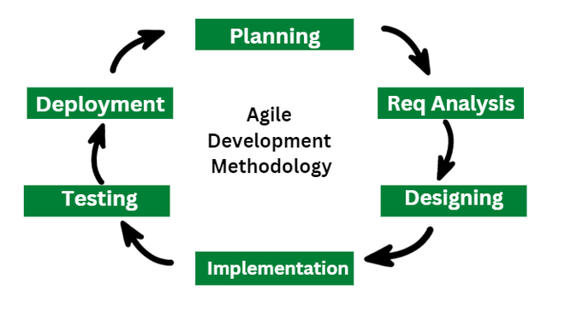
DEVELOPMENT MODEL
Fig 1 : Agile Development Methodology Model

Slide 9
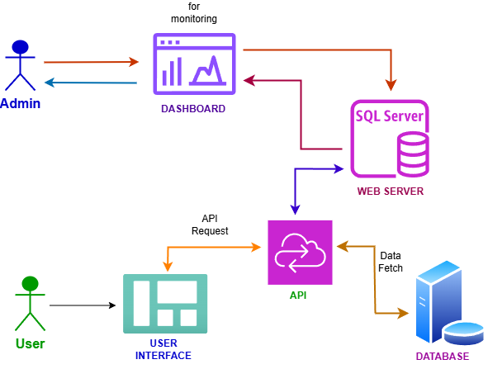
SYSTEM ARCHITECTURE

Slide 10
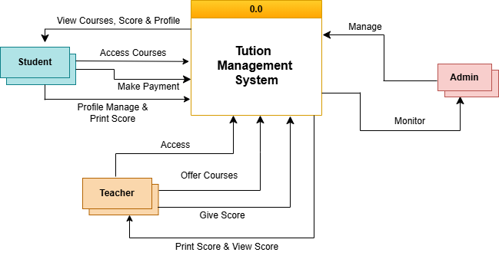
CONTEXT LEVEL DIAGRAM

Slide 11
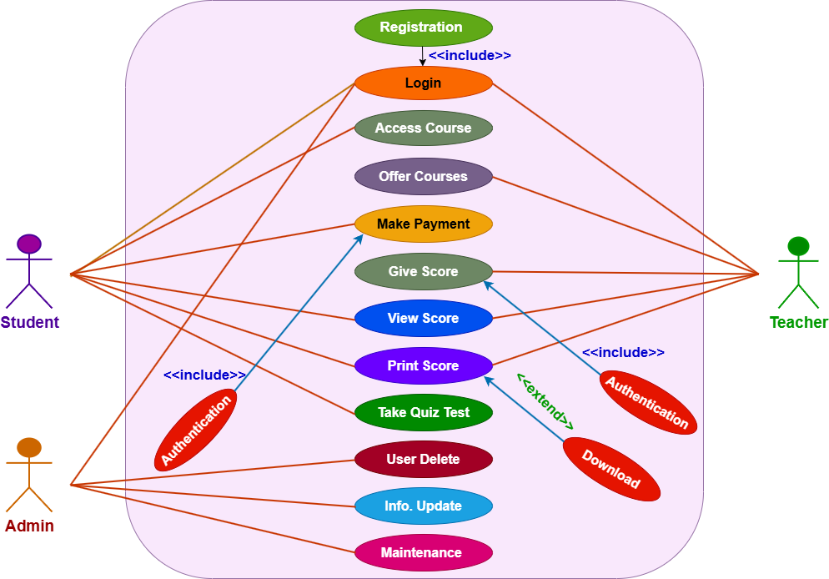
USE CASE DIAGRAM

Slide 12
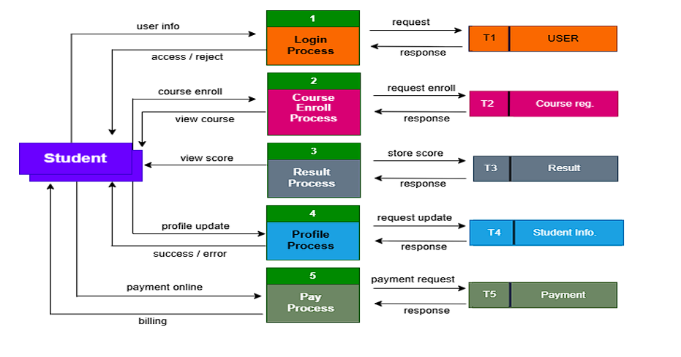
DATA FLOW DIAGRAM

Slide 13
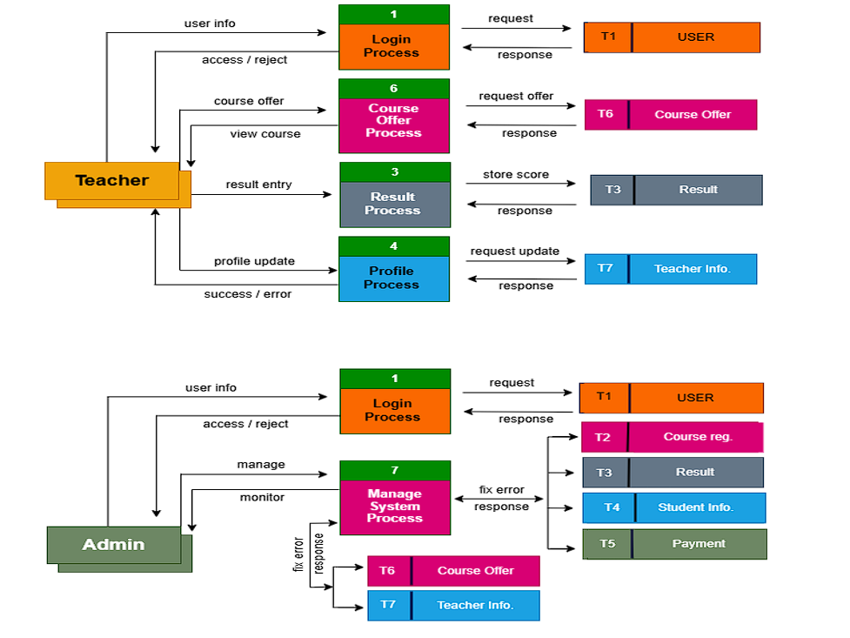

Slide 14
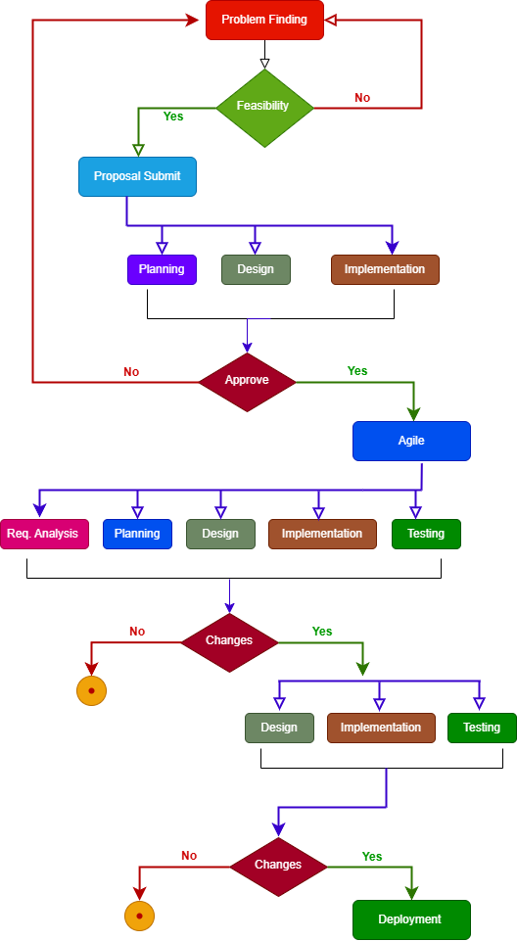
SYSTEM FLOWCHART

Slide 15
SYSTEM REQUIREMENT
Hardware Requirement
CPU: Core i3 4th Generation or equivalent (or better).
Disk Space: 200 MB or more.
RAM: 1 GB or better.
Monitor: 15” VGA Color or better.
Software Requirement
Operating System: Windows 7/8/10/11.
Development Environment: Microsoft Visual Studio (for C# development).
Backend: XAMPP, SQL Server (or any SQL-based server compatible with the application).
Technology: ASP.NET (for web functionalities), C# (for application logic).
Database Management: XAMPP, SQL Server.

Slide 16
MODULES
Student Management Module
Course Access
Profile Management
Assessment Participation
Result Viewing
Signup Process
Login Process
Teacher Management Module
System Access with Signup / Login
Course Management
Exam Evaluation
Performance Tracking
Admin Management Module
System Monitoring
User Management
System Maintenance
Authentication and Interface Module
Unique Email or Phone Based Signup
Secure Login
Role-Based Interfaces
Student Interface
Teacher Interface

Slide 17
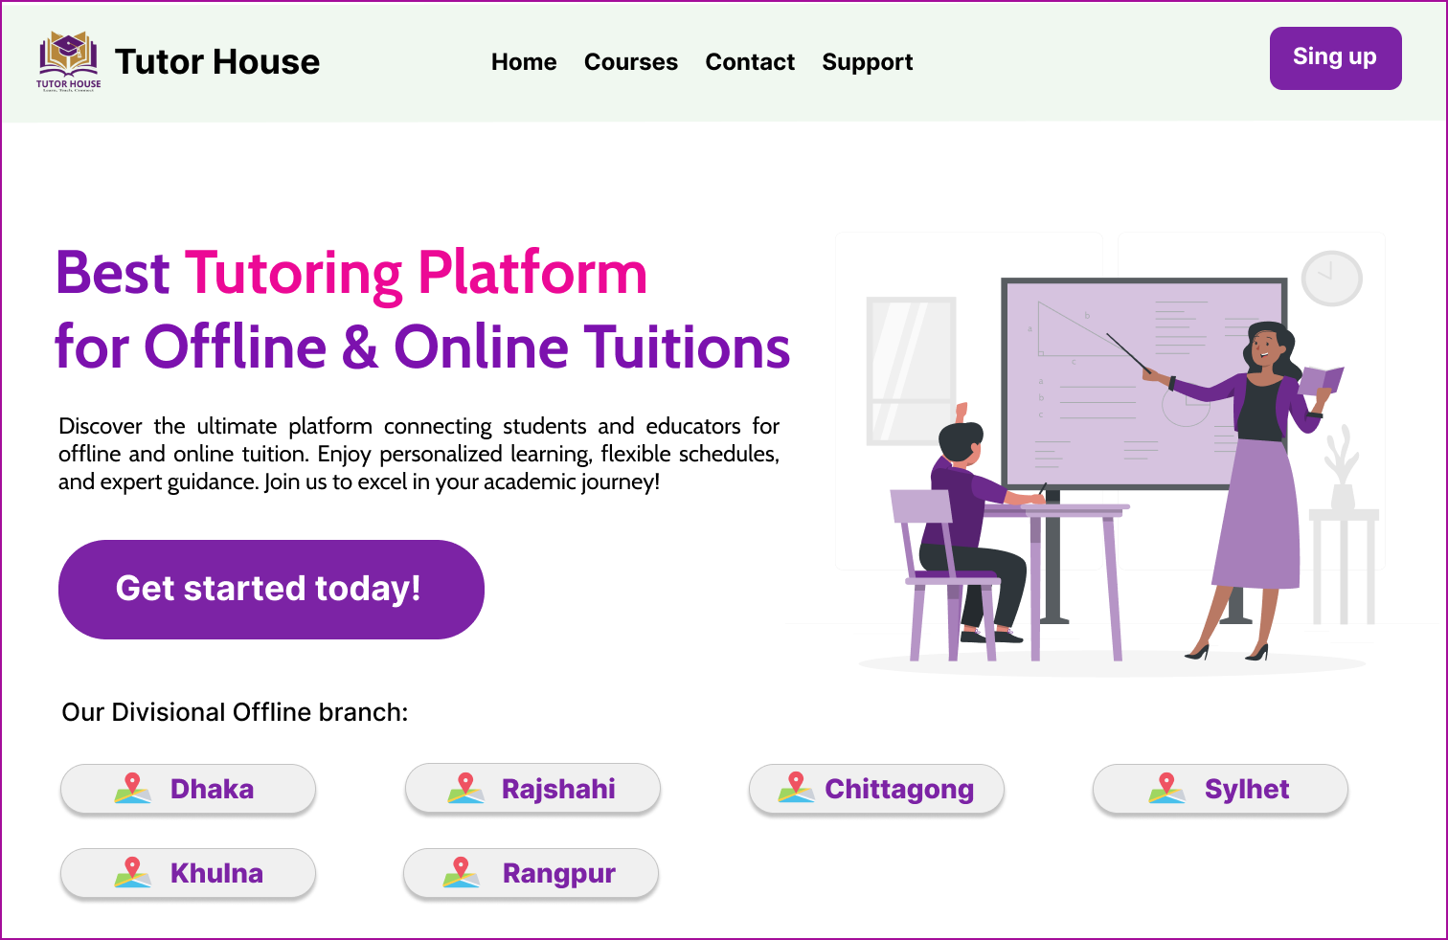
PROTOTYPE DESIGNS
1. Home Page

Slide 18
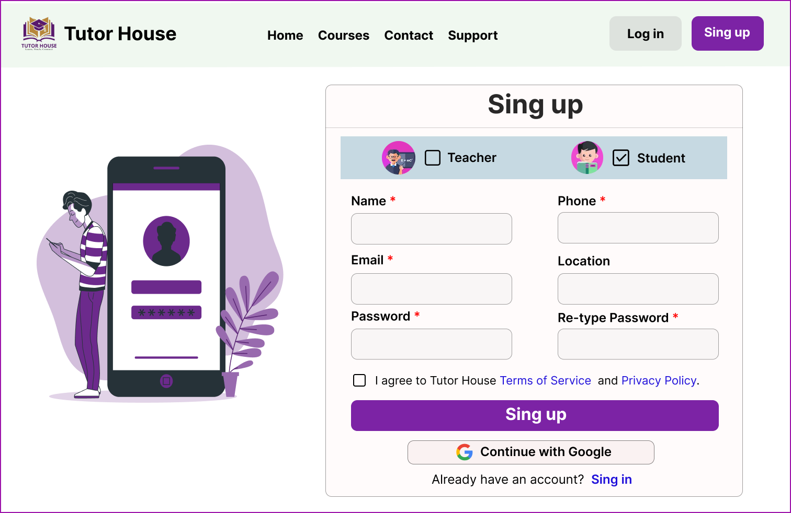
2. Sign up Page

Slide 19
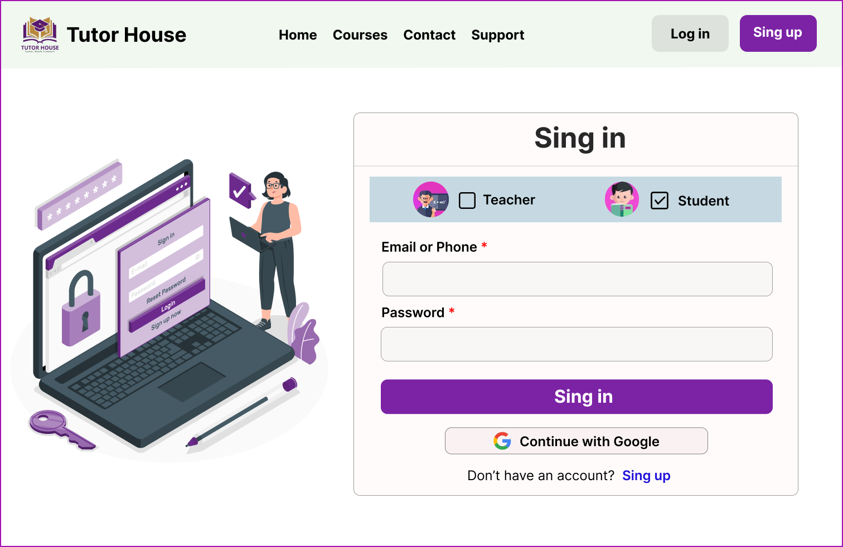
3. Login Page

Slide 20
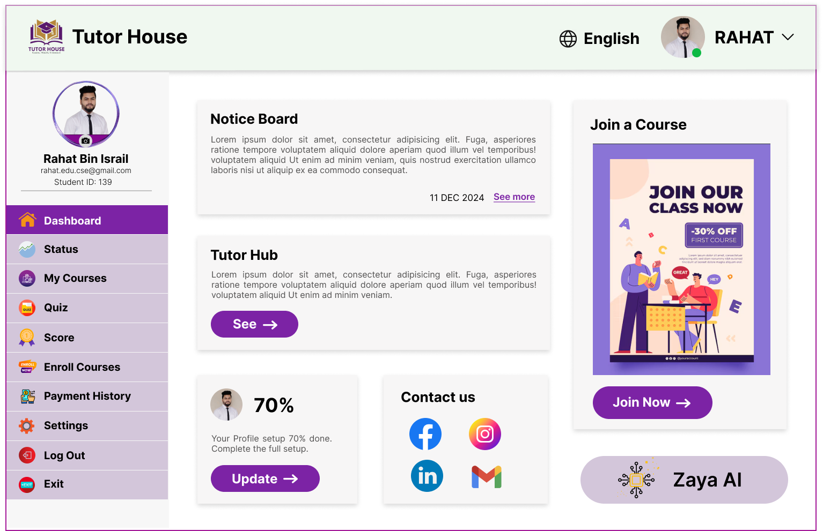
4. Dashboard

Slide 21
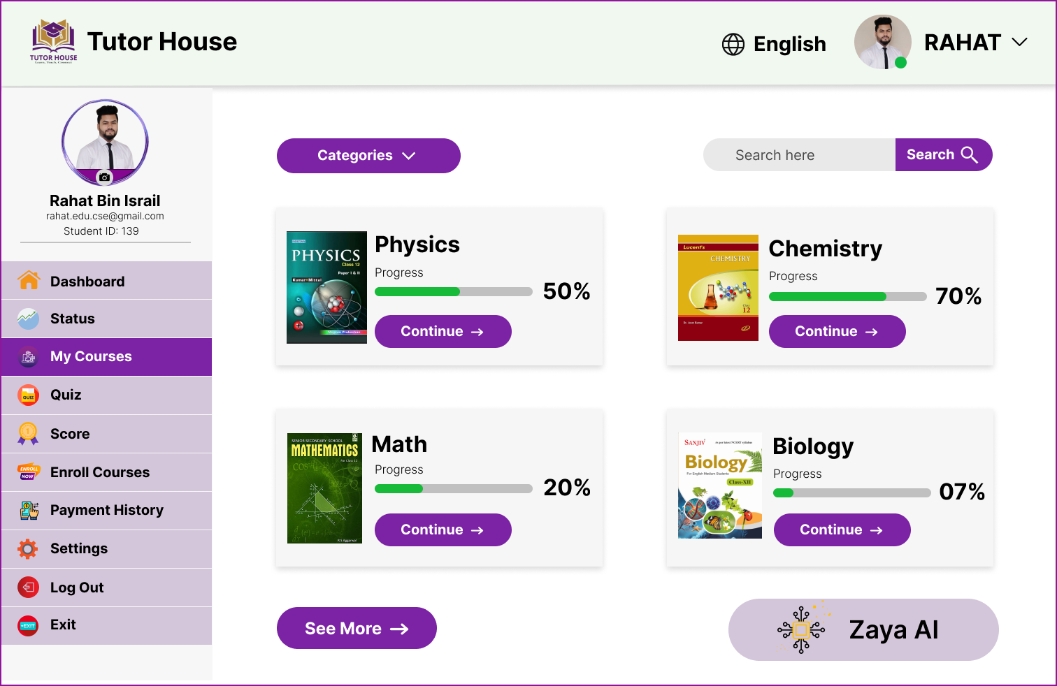
5. My Courses

Slide 22
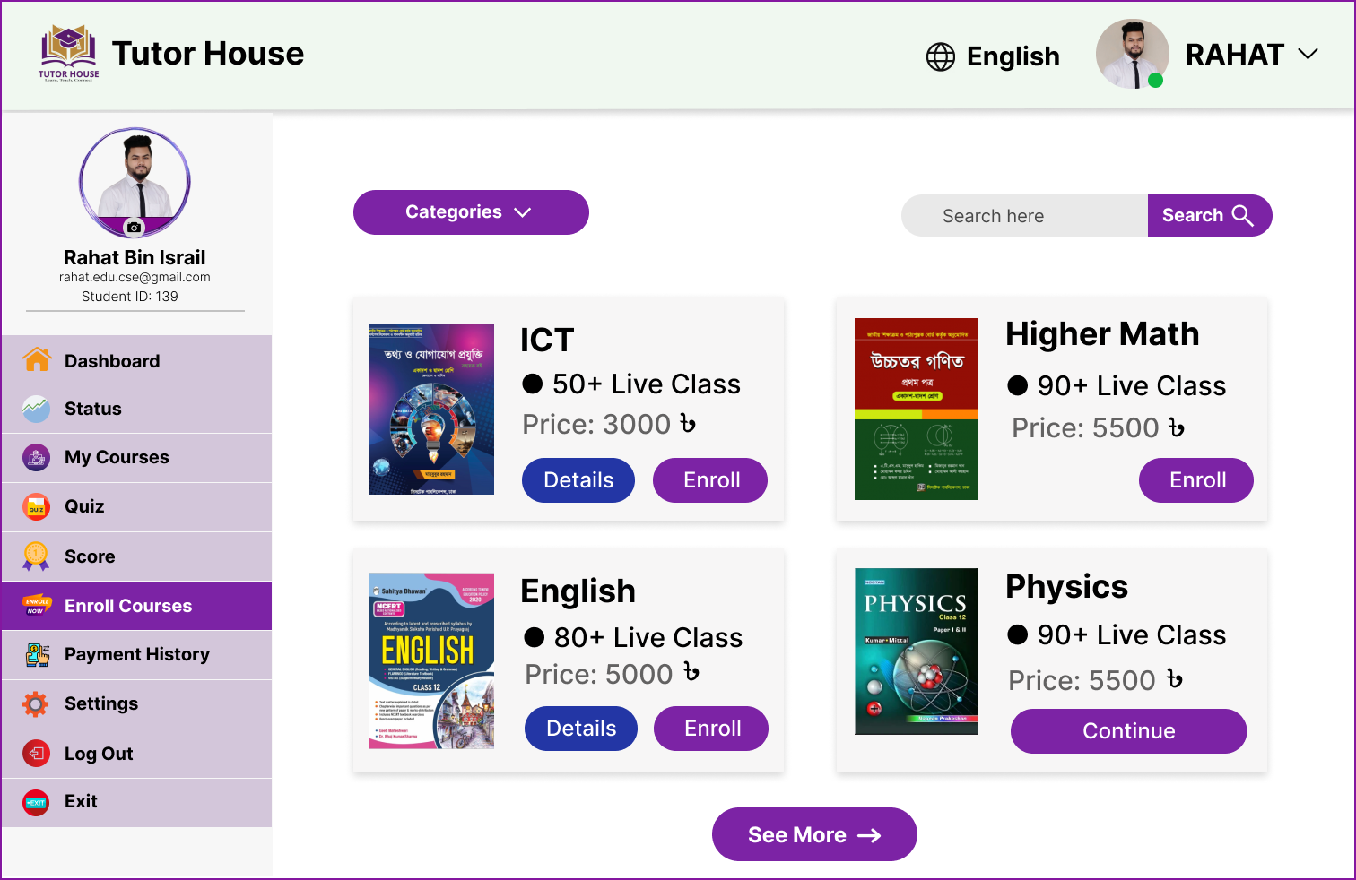
6. Enroll Courses

Slide 23
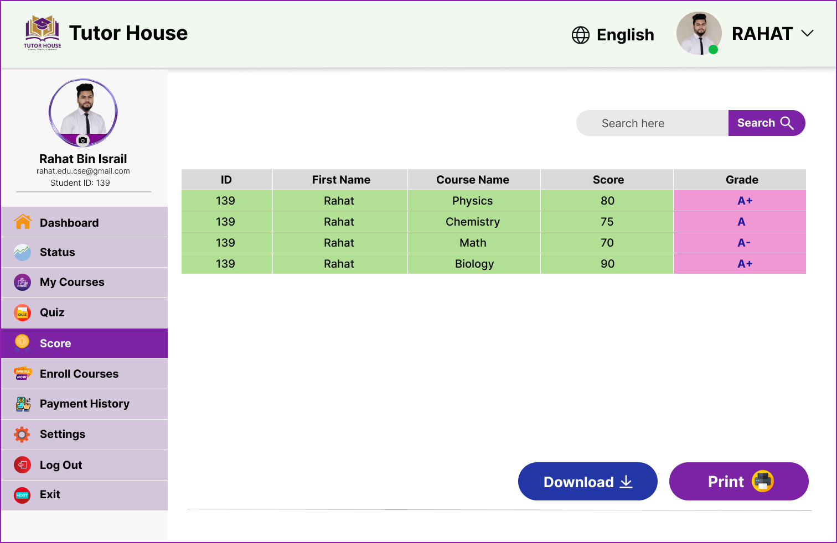
7. Score

Slide 24
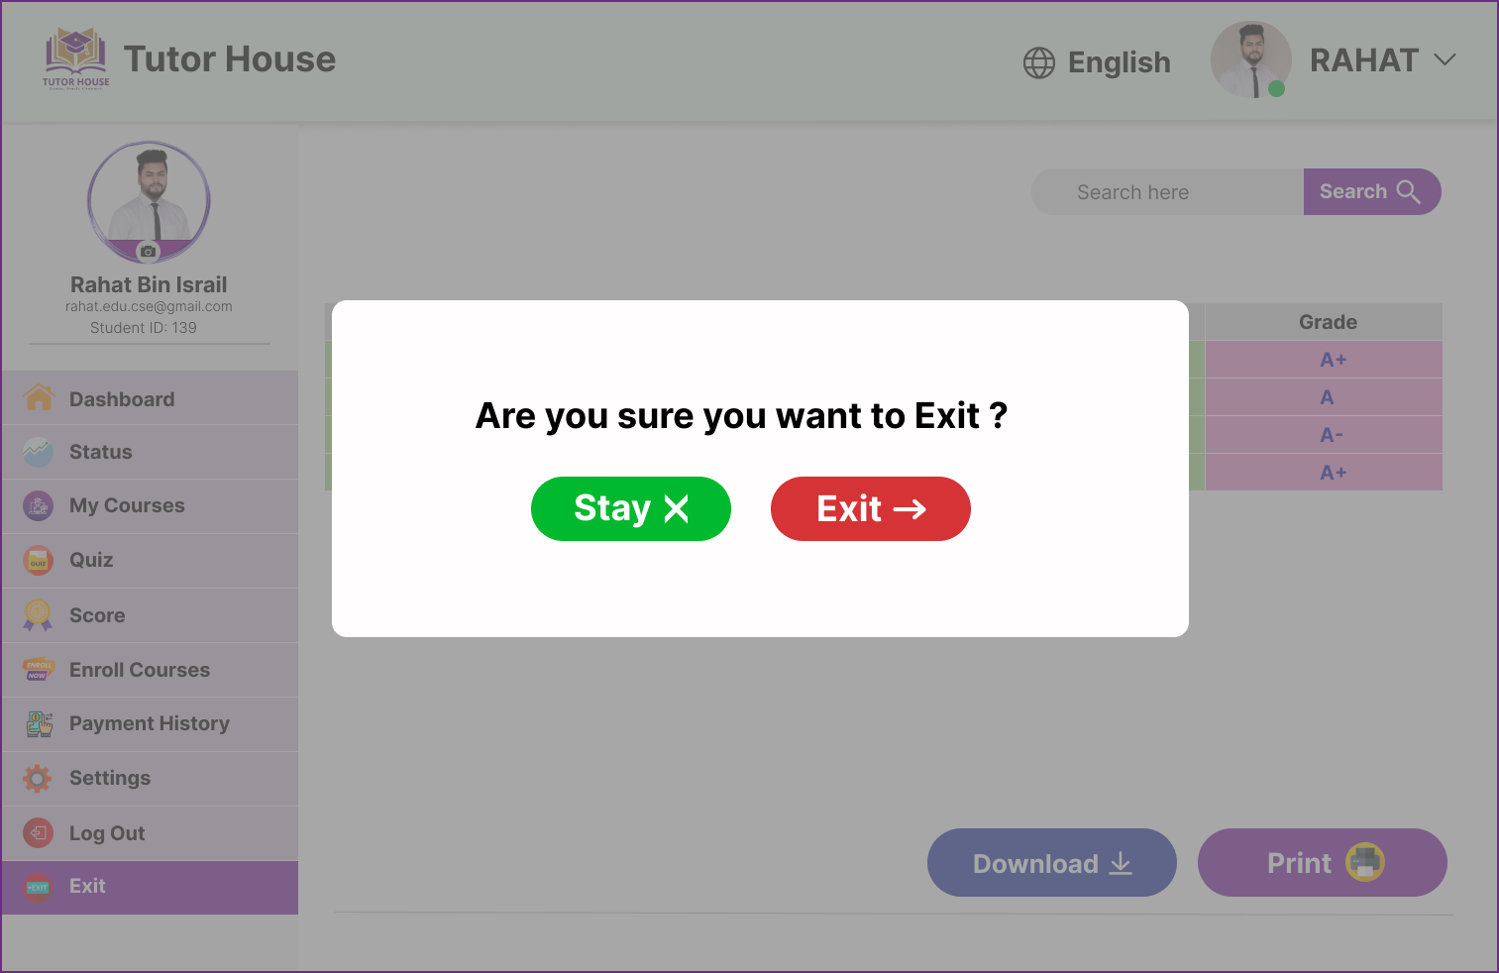
8. Exit

Slide 25
FUTURE WORKS
Enhanced Reporting and Analytics: Future updates could focus on deeper insights into student performance, tutor effectiveness, and course analytics.
Mobile App Development: Extend the system to mobile platforms with additional features like push notifications and mobile payments.
Gamification:
Badges and Achievements: Rewarding students for completing courses, achieving high scores, or maintaining consistent attendance.
Leaderboards: Encouraging healthy competition by displaying top-performing students in quizzes, exams, or overall performance.
Interactive Quizzes: Adding timed challenges and rewards for quick and accurate responses.
Progress Tracking: Allowing students to visualize their learning journey with milestone-based progress indicators.

Slide 26
CONCLUSION
The C# Desktop-based Tuition Management System was developed as a robust solution for tutoring centers, addressing challenges like student management, session scheduling, and payment tracking using C#, SQL Server, and Windows Forms. The Agile Development Model ensured flexibility, iterative improvements, and user satisfaction. Its modular design and scalability allow for future enhancements, such as advanced reporting and online platform integration. Overall, the project effectively applies theoretical and technological knowledge, offering a practical solution for efficient tutoring operations

Slide 27


